Slide 1


Slide 2
Embedded Systems

Slide 3
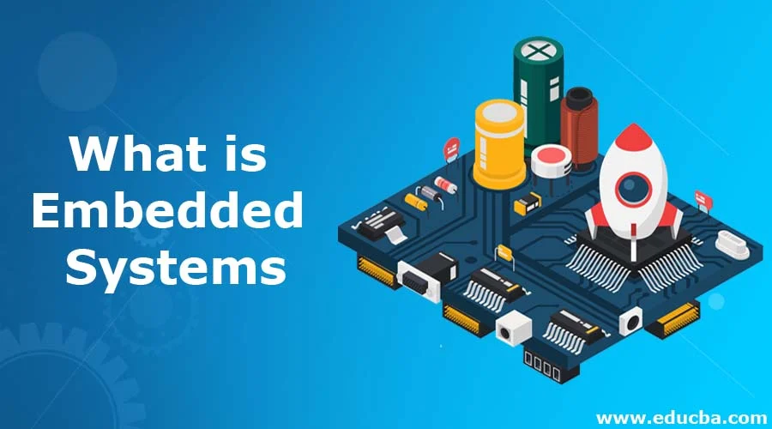
1. What is an Embedded System ?
An Embedded System is a combination of computer hardware and software designed to perform a specific function or set of functions.

Slide 4
Key Characteristics of Embedded Systems:
Contains a processing unit
Includes temporary memory (RAM) and permanent storage (Flash, ROM)
Customized for specific applications
Low cost compared to general-purpose computers

Slide 5
2. Real-life Example: Smartphone
A smartphone is a complex system with multiple embedded components. Each component can be considered an embedded system in itself:

Slide 6
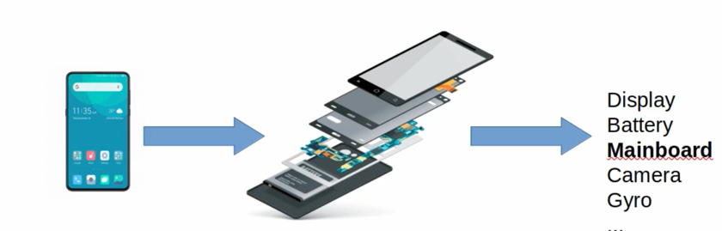
Display | Controlled by a microcontroller with specific display memory
Battery | Has its own circuitry for power management and protection
Main Board | Central processing unit (CPU) for running OS and applications
Camera | Often includes its own image signal processor (ISP)
Gyroscope Sensor | Uses its own processor to detect orientation and motion

Slide 7
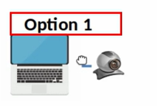
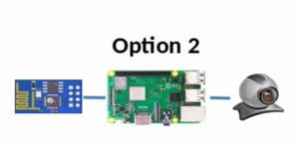
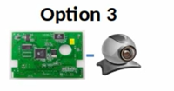
3. Software Perspective: Security System Example
Option 1: Use a General-Purpose Computer
Attach a camera and develop an intruder detection app.
Pros: Easy and fast to develop
Cons: Expensive (e.g., ₹100,000 for PC + ₹3,500 camera), overkill features like display, keyboard, etc.
Option 2: Use a Raspberry Pi (General-Purpose Embedded Board)
Attach a camera and write custom software.
Cost: ₹4,000 (Raspberry Pi) + ₹3,500 (camera) + ₹1,000 (Wi-Fi) ≈ ₹6,500
Still not optimal: It has unused hardware like:
HDMI port & controller
USB ports & controllers
Ethernet port & controller
Option 3: Custom Embedded System
Based on Raspberry Pi design, a hardware engineer builds a custom PCB:
Removes HDMI, Ethernet, USB, etc.
Adds only essential components like Wi-Fi module
Embedded software engineers write software to handle alert functionality
Cost: ₹1,000 (custom board) + ₹3,500 (camera)

Slide 8
4. Where Are Embedded Systems Found?
TVs
Home Appliances
Gaming Consoles
Automobiles
Medical Devices
Industrial Robots

Slide 9
5. Advantages and Disadvantages
✅ Pros:
Cost-efficient
Purpose-built for specific tasks
Optimized performance and user experience
❌ Cons:
Hardware constraints (limited RAM, CPU, I/O)
Longer development time compared to PCs

Slide 10
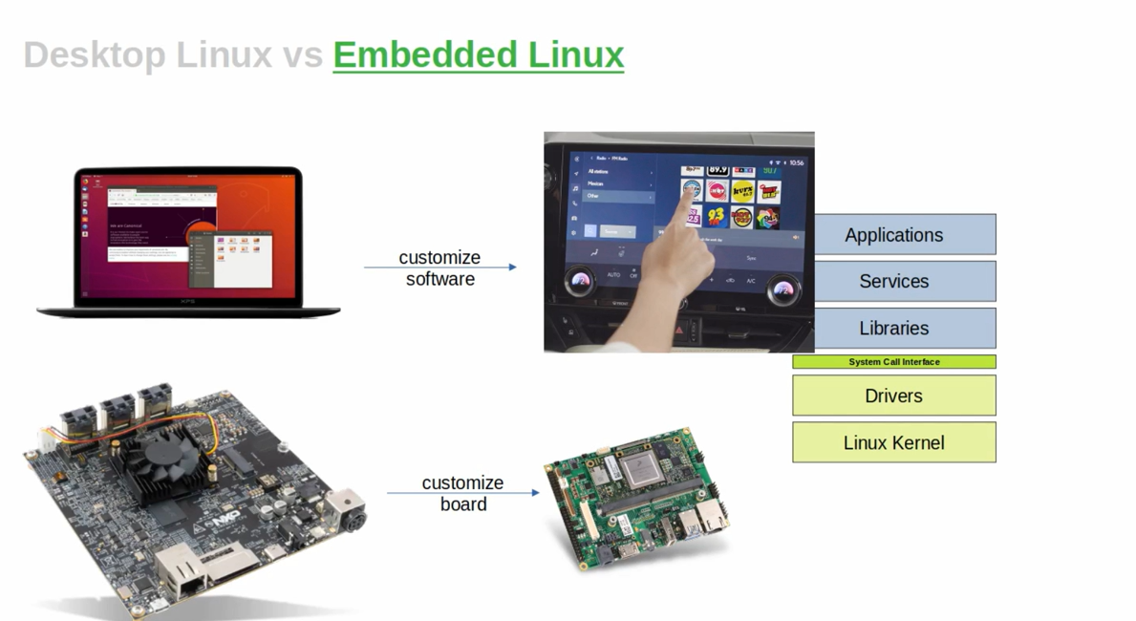
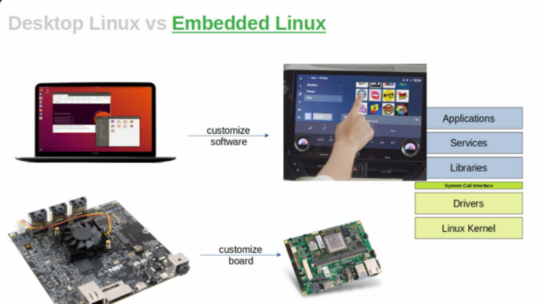
6. Desktop Linux vs Embedded Linux

Slide 11
🖥️ Desktop Linux ⚙️ Embedded Linux
Runs on general-purpose hardware (laptops, desktops).
Uses ready-made boards (e.g., Intel, AMD PCs).
Focus is on software customization:
Install apps like browsers, IDEs, and office tools.
GUI environments like GNOME or KDE.
Rich hardware support by default (keyboard, display, Wi-Fi, etc.).
💡 Key point: You don’t change the hardware — you install or remove software as needed.
Runs on custom-designed hardware (like Raspberry Pi board shown).
Focus is on board customization:
Choose CPU, RAM, I/O based on the use-case.
Remove unused features (e.g., HDMI, Ethernet).
Optimize for power, performance, and size.
Software is tightly integrated with the hardware:
Minimal libraries and services.
Often no full desktop environment — may be CLI or lightweight GUI (Qt, GTK).
💡 Key point: You design or modify the hardware and create a tailored OS to match.

Slide 12
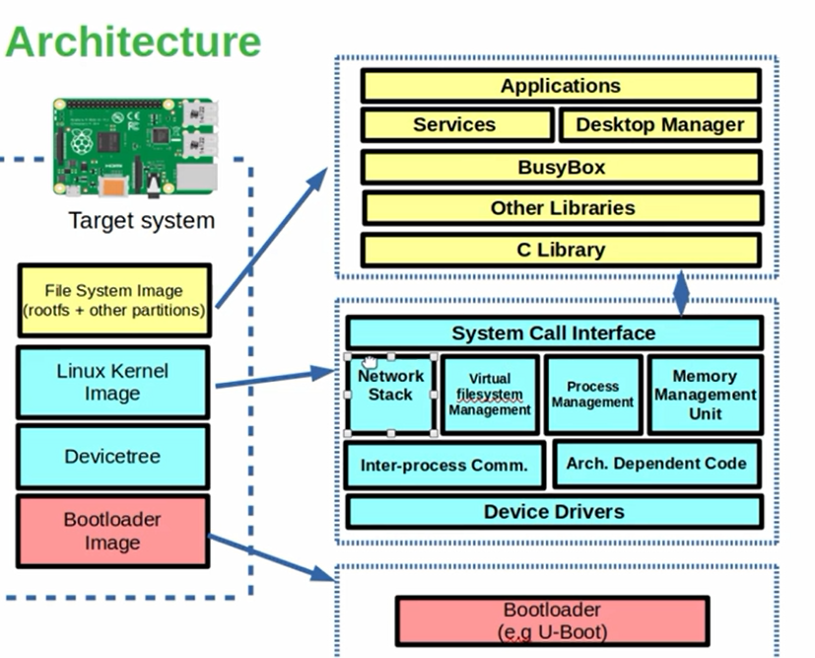
Embedded Linux Architecture

Slide 13
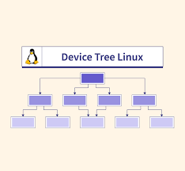
Bootloader
Initializes core components such as CPU, RAM and Memory etc. and loads the Linux kernel into memory.
Primary Bootloader
Secondary Bootloader: Load Linux Kernal Image to RAM.
Device tree ---- device tree is a data structure that describes the hardware components of a system, including CPUs, memory, buses, and peripherals. It's a hierarchical tree-like representation of the hardware, with nodes representing devices and properties providing details about them

Slide 14
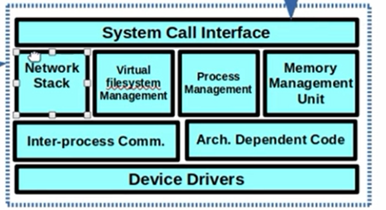
Linux Kernel Image
Linux Kernel Image Breakdown
Code that implements OS functionality:
Network Stack: Enables use of TCP/IP, UDP, Wi-Fi, etc.
Virtual File System (VFS): Manages partitioned file systems.
Process Management: Handles scheduling, threads, priorities.
Memory Management Unit (MMU): Maps virtual to physical memory, ensures protection.
Inter-Process Communication (IPC): Allows processes to share data and sync. C
Architecture-Dependent ode: Code specific to CPU/memory/bus architectures.
Device Drivers: Interfaces to control and use hardware like USB, SPI, display.
System Call Interface: Allows user-space programs to request kernel services

Slide 15
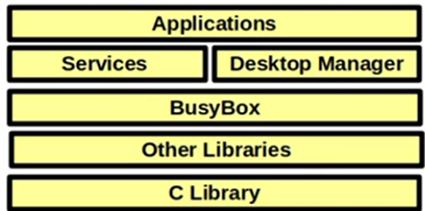
Applications: End-user programs that perform specific tasks on the system.
Services: Background programs (daemons) that run automatically to support functionality.
Desktop Manager: Provides the graphical user interface (GUI) for user interaction.
BusyBox: A single binary offering essential Unix command-line tools in a compact form.
Other Libraries: Shared code that provides functionality to applications (e.g., graphics, networking).
C Library: Core library that connects applications to the Linux kernel using system calls.

Slide 16
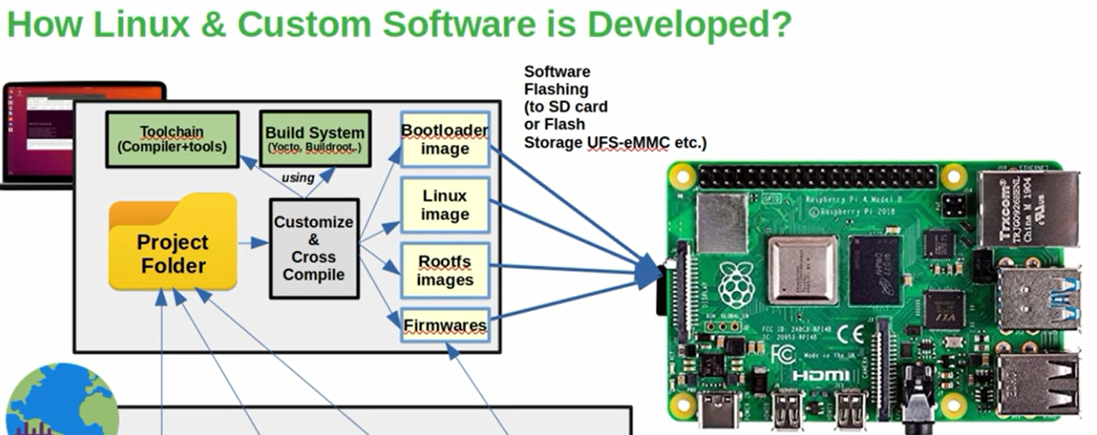

Slide 17
Root File System (RootFS) Image
Contains user-space directories: /bin, /lib, /etc, etc.
Includes BusyBox, libraries, services, configs
BusyBox is a software suite that provides a collection of common Unix utilities, all bundled into a single, small executable file.
The Swiss Army Knife of Embedded Linux
Firmware
Firmware is a generic term for any software that's permanently programmed or flashed into a device to make hardware usable.
\May include bootloader + kernel + rootfs
🧰 1. Toolchain (Compiler + Tools)
🔧 What is a Toolchain?
A toolchain is a set of tools used to compile source code into binary executables that run on your target hardware (not your PC).
💡 It is mainly used for cross-compiling — compiling on one machine (host PC) for another (embedded target).

Slide 18
🔗 Common Tool in a Toolchain:
Tool Purpose
gcc Compiler: Converts C/C++ to machine code
Compiler (gcc) – Converts code to machine language
Linker – Combines pieces into one program
Debugger (gdb) – Helps you fix errors

Slide 20
What is YOCTO ?
Build system used to create custom Linux distributions.
What is Linux distribution? :
1. Linux is divided into two parts one is user space and another is
kernel space the part that divides the user space and kernel space
is Linux kernel
2.Linux OS is built around the Linux kernel Linux OS means system
utilities and applications in user space and hardware, device
drivers, bootloader in kernel space, is called Linux distribution.

Slide 21
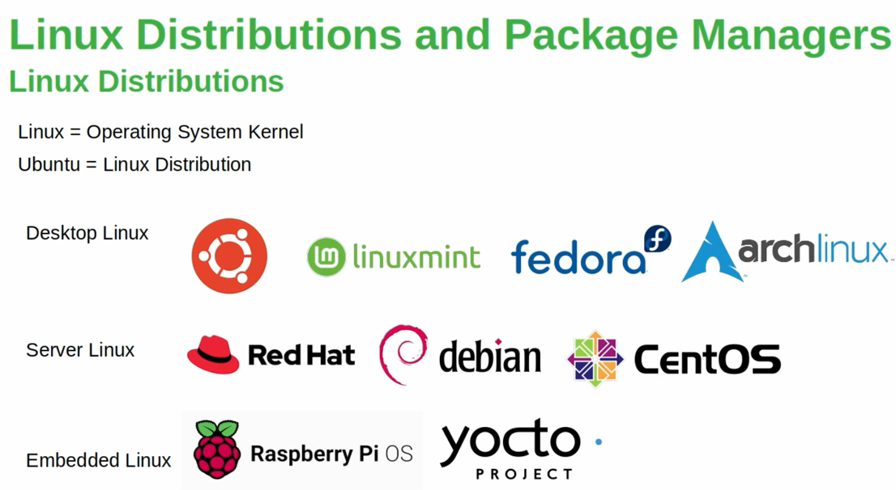





Slide 22
Why Use Yocto ?
Highly Customizable : select what you need such as drivers, libraries, features.
Industry Grade Tool Chain : Widely adopted by companies.
Layer Bases Workflow : Use/Write Reproducible “ Layers “

Slide 23
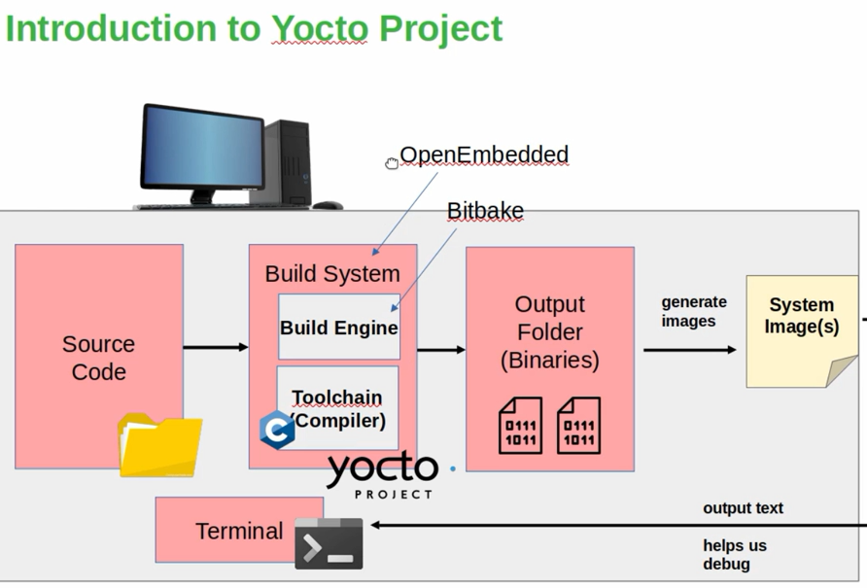

Slide 24
1. Source Code
➡️ Contains the raw application code, kernel, bootloader, and configuration files used in the build process.
2. Build System
➡️ The central part of Yocto that controls how software is built and assembled into images.
Build Engine
Coordinates all tasks required to build the system.
Uses BitBake to execute tasks defined in recipes.
Toolchain (Compiler)
A set of tools (like gcc, ld, gdb) used to compile code for a target device (cross-compilation)
3. BitBake
➡️ The task executor — reads recipes and runs each step (fetch, configure, compile, install) to build packages.
4. OpenEmbedded
➡️ A collection of metadata (layers, recipes) that tells BitBake how to build software.
5. Output Folder (Binaries)
➡️ Stores the compiled results (binaries) such as:
Kernel image (zImage, Image)
Root filesystem (rootfs.ext4)
Bootloader (u-boot.bin)
App binaries

Slide 25
6. System Image(s)
➡️ The final output image (e.g., .img, .wic) which can be flashed onto your embedded device (like Raspberry Pi).
7. Terminal
➡️ Interface where developers interact with the Yocto build system.
Used to run BitBake commands
Shows logs, errors, and debug output.

